Slide 1


August 16, 2024
Thorin Tabor Anthony Castanza Alex Wenzel Ted Liefeld
Integrative Genomic Analysis
with
Notes:
Hello and welcome to today’s GenePattern workshop. We have four presenters for you today: I’m Thorin Tabor, I will be helping you learn how to get your data into GenePattern and going over differential analysis. Anthony Castanza will be presenting Gene Set Enrichment Analysis and MSigDB. Ted Liefeld, will be covering Classification & Prediction and IGV. And finally, Alex Wenzel will go over single-cell RNA-seq clustering.

Slide 2
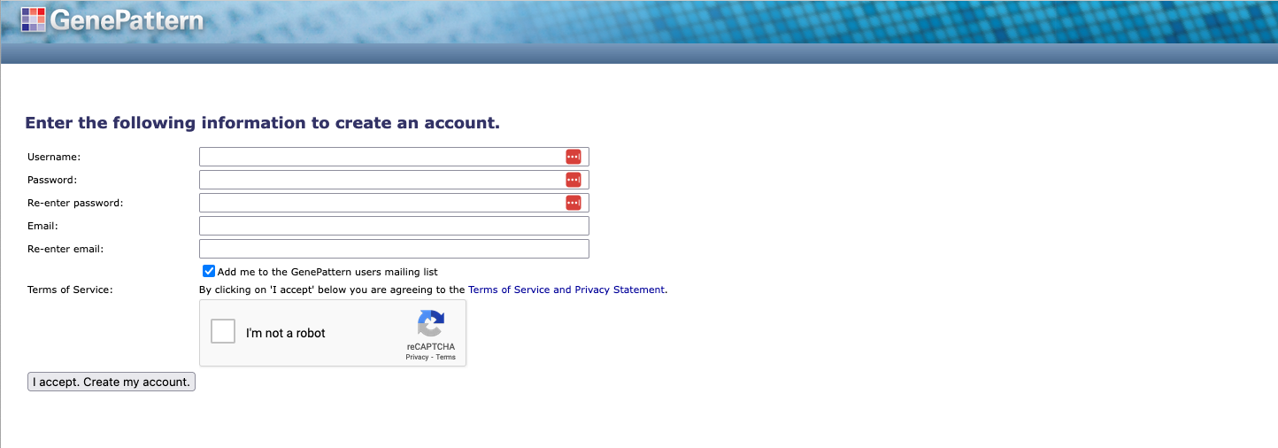
1. Register for an account at:
cloud.genepattern.org
No spaces or special characters in usernames
!@#$%
^&*()_
Notes:
As the different sections of today’s workshop are intended to be interactive, you will need to create a GenePattern account if you don’t already have one, and sign in to the GenePattern web app.
You can find GenePattern at the URL shown on this slide. That’s cloud (dot) genepattern (dot) org. If you already have an account, simply sign in with your username and password. Otherwise, if you don’t have an account, click the “Click to Register” link, and follow the instructions.
Side note: If you are making a new account, please do not use any special characters or spaces in your username.
I’ll give everyone a couple minutes. Please do this now.

Slide 3
Agenda
Overview
Data Prep
Differential Analysis
GSEA
MSigDB
Break
Classification & Prediction
IGV
Single-cell RNA-Seq Clustering
Closing
Notes:
Here is today’s agenda. If we stay on schedule, we should be concluding the workshop around noon today.

Slide 4

GenePattern Overview
Notes:
Sound good? Let’s begin an overview of the GenePattern platform for reproducible bioinformatics.

Slide 5
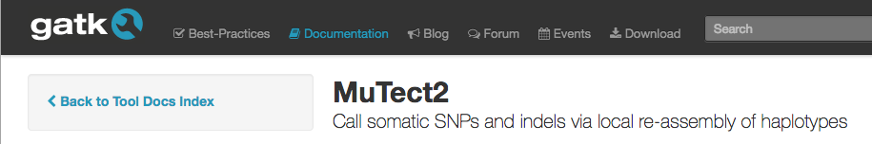
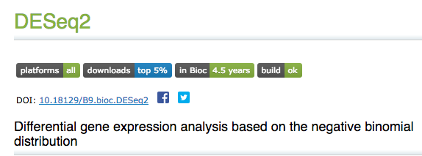
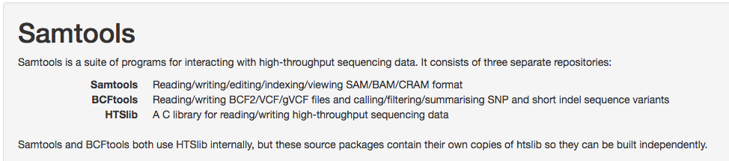

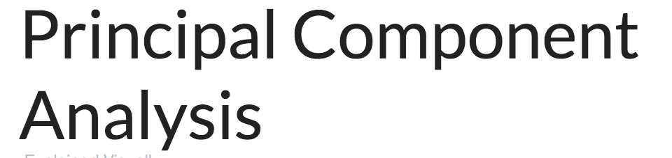
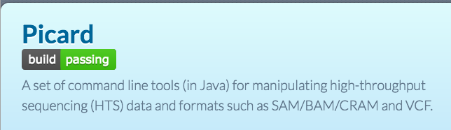

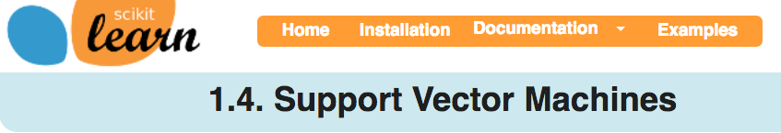

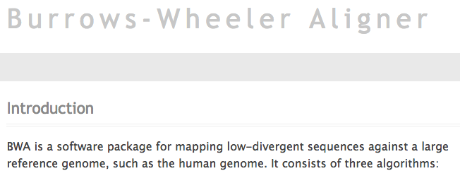
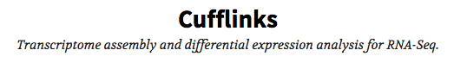
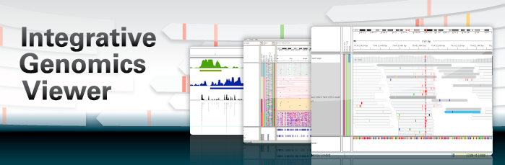
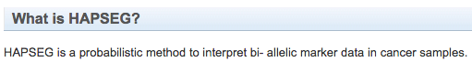
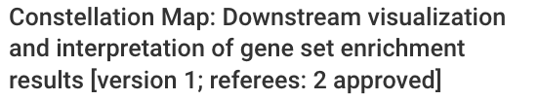
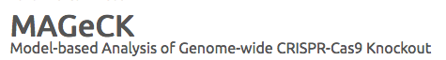
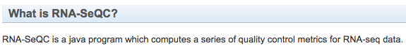
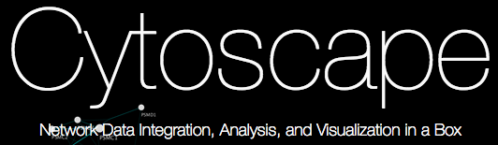
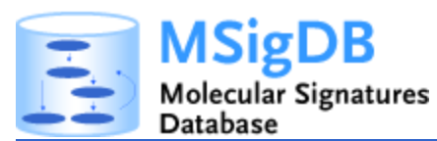

Tools for Bioinformatics
Notes:
Does anyone have a guess for how many bioinformatics tools there are?
*Take a guess or two from the classroom.*
Well, we did a survey of the number of available bioinformatics tools a few years back, and the answer is that there over 10,000 available out there on the internet.
Needless to say, that’s a lot.

Slide 6
Problems with bioinformatics tool use and interoperability
Tools are built using different languages and with different architectural assumptions.
Each tool has its own installation and operational requirements.
Tools require (sometimes extensive) Unix knowledge.
Tools are not designed to communicate with each other.
bowtie -a --best --strata -S -m 100 -X 400 --chunkmbs 256 --fullref -p 4 Dmel.BDGP5-transcripts \ -1 SRR031714_1.fastq -2 SRR031714_2.fastq | samtools view -F 0xC -bS - | \ samtools sort -n - ~/Desktop/untreated3-transcriptome
Notes:
And many of those come with a rather steep learning curve and require a fair amount of technical expertise to run successfully. Each tool has its own installation and operational requirements, such as programmatic dependencies. Different tools are written in different programming languages and may have different architectural assumptions. And many tools require execution from the command line, which demands unix knowledge – and sometimes quite extensive unix knowledge at that.
For example, on this slide you can the command line necessary to use a tool called bowtie to align a sequence to a genome and then sort the resulting alignments by genomic coordinates.
And finally, many bioinformatics tools developed on their own, and aren’t designed to communicate and share data with the other available tools.
All of this means that there are often a variety of technical hurdles that must be overcome before you even begin to get to the good stuff – the science.

Slide 7
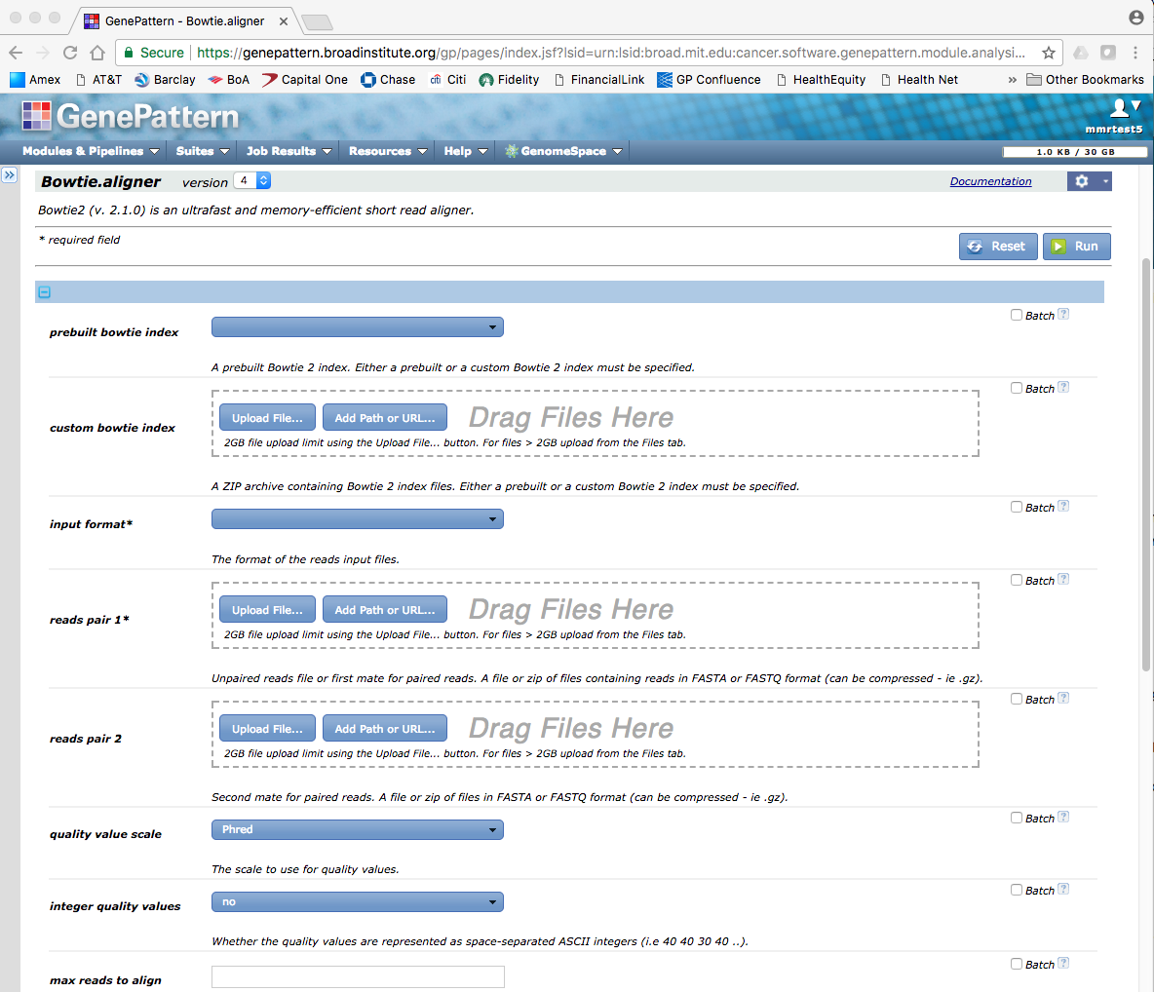
Solution features: Wrapping tools
“Wrap” tools in a web-based interface
No installation/running requirements
No programming required
Fill out required parameters and provide input files
Notes:
That’s where GenePattern comes in.
Our solution is to wrap available bioinformatics tools in a simple, web-based interface. This allows you to run the available tools simply by filling out a web form with the required parameters and clicking the Run button. No installation and no programming required.

Slide 8
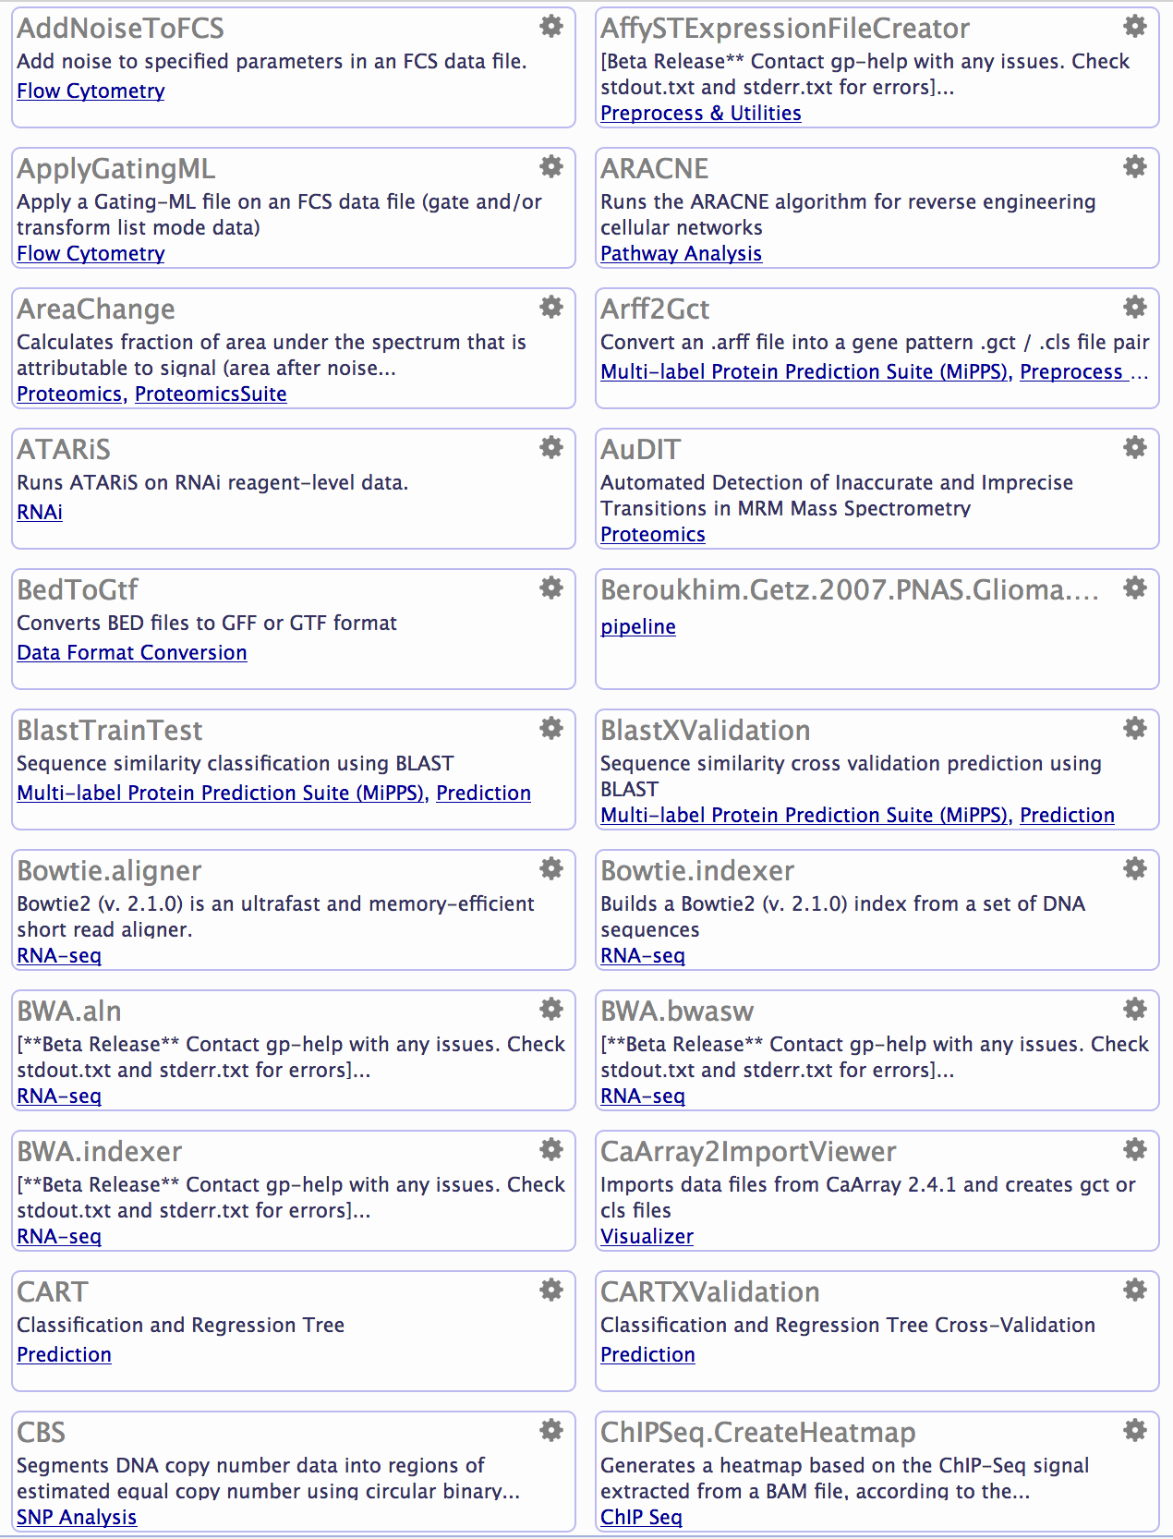
Solution features: Tool Repository
Collection of hundreds of wrapped tools
Gene expression, sequence variation, proteomics, network analysis, machine learning, flow cytometry, etc.
Searchable by name, keyword, etc.
Widely-used community tools, lab-developed tools, utilities
Users can contribute their own tools
Notes:
And rather than scouring the internet for hours, looking for the various available tools, GenePattern provides a curated repository of available “modules.” This repository includes includes hundreds of wrapped tools, including tools for gene expression, sequence variation, proteomics, network analysis, machine learning, flow cytometry and single-cell.
All tools are searchable by name and keyword, or can be browsed by category. It includes the most widely used bioinformatics community tools, as well as tools that we’ve developed in our lab. If you’re a developer, you can also contribute your own tools.

Slide 9
Solution features: Reproducibility
Record and replay of all analyses
Retain all versions of code – so results can be reproduced even if code changes
Chain analyses into “pipelines”, or workflows that can be shared and published
Notes:
Finally, GenePattern allows you to easily send data from one tool to another, making it easier for the various tools to work together. You can also chain the inputs and outputs of several tools together, to form a complete workflow, which you can then save and replay, run variations on different data or share with others.
This makes your science dependable, collaborative and reproducible.

Slide 10
GenePattern vocabulary: Modules
Copy Number
Divide
by Normals
GSEA
Variation
Filter
GISTIC
CBS
k-Nearest
Neighbors
Classification
and
Regression Trees
Support
Vector
Machines
Hierarchical
Clustering
GISTIC
Expression
File
Creator
Metagene
Projection
Notes:
I’ve mentioned the word “module” once already, but let me take a moment to define what I mean. Today, when we talk about modules, we’re talking about a specific bioinformatics tool or other piece of software that has been wrapped in a handy-dandy web form for use in GenePattern.

Slide 11
GenePattern vocabulary: Modules
Copy Number
Divide
by Normals
GSEA
Variation
Filter
Hierarchical Clustering
Files
HCL.jar
cluster.exe
ant.jar
gp-modules.jar
Jama-1.0.2.jar
Documentation
HierarchicalClustering.pdf
Parameter descriptions
-f <input.filename>
<log.transform>
<row.center>
<row.normalize>
<column.center>
<column.normalize>
-u <output.base.name>
-e <column.distance.measure>
-g <row.distance.measure>
-m <clustering.method>
GISTIC
CBS
k-Nearest
Neighbors
Classification
and
Regression Trees
Support
Vector
Machines
Hierarchical
Clustering
GISTIC
Expression
File
Creator
Metagene
Projection
Notes:
I want to note that modules are self-contained. They contain all of the files needed to run that particular analysis, including binaries, dependencies, a parameter specification and documentation.
This makes them portable. Once wrapped, a module can be run on different GenePattern servers, whether the official one or your own. And can be run on any operating system, from Mac, to Linux, to Windows.

Slide 12
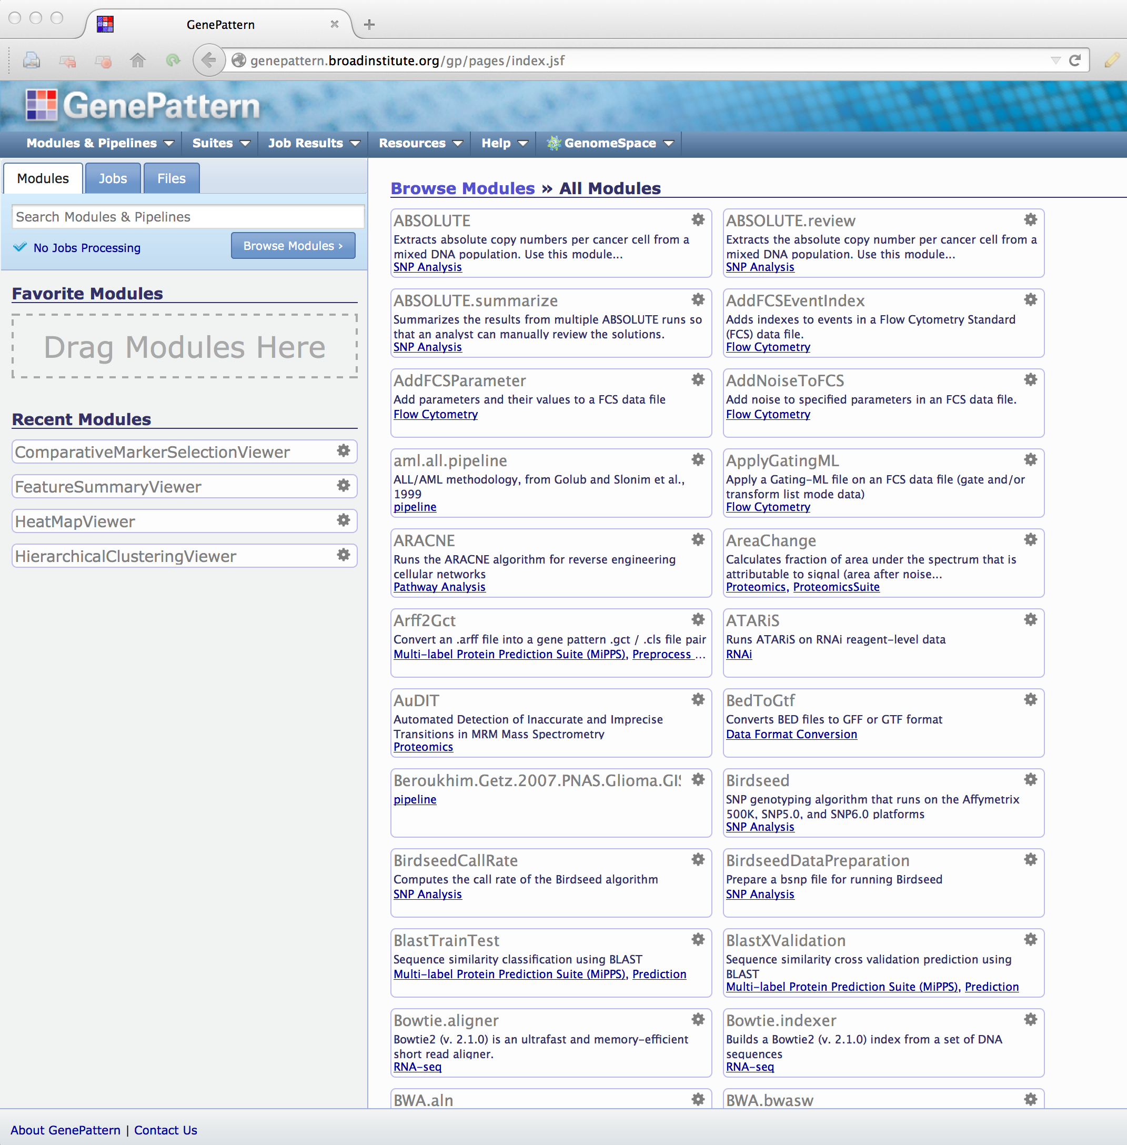
>250 GenePattern Modules, 08/2024
Notes:
And at least count, we currently have over 250 modules available on the GenePattern public server, with more being added on a regular basis.

Slide 13
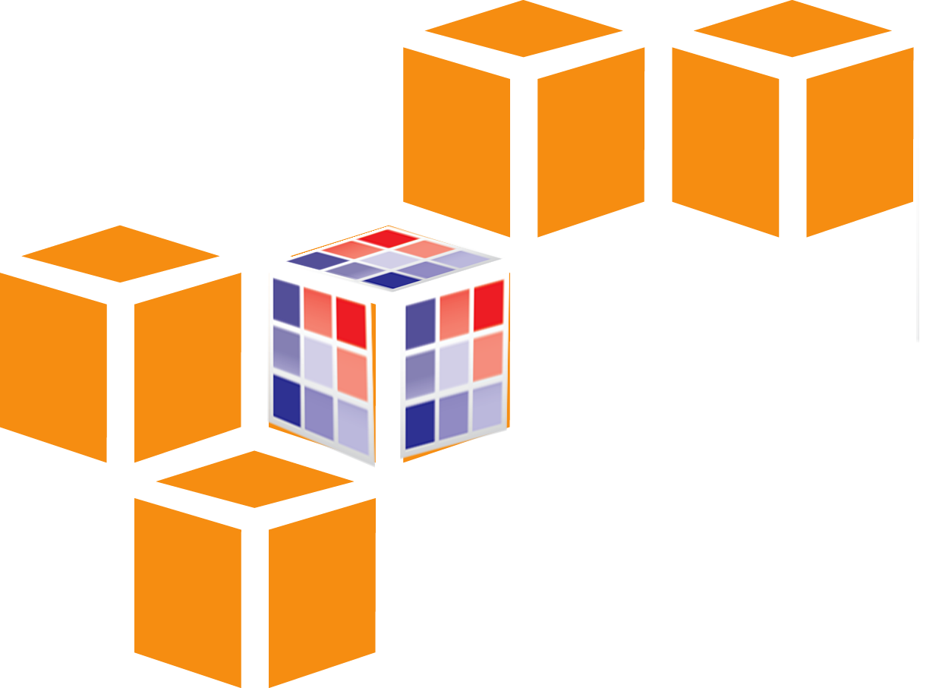

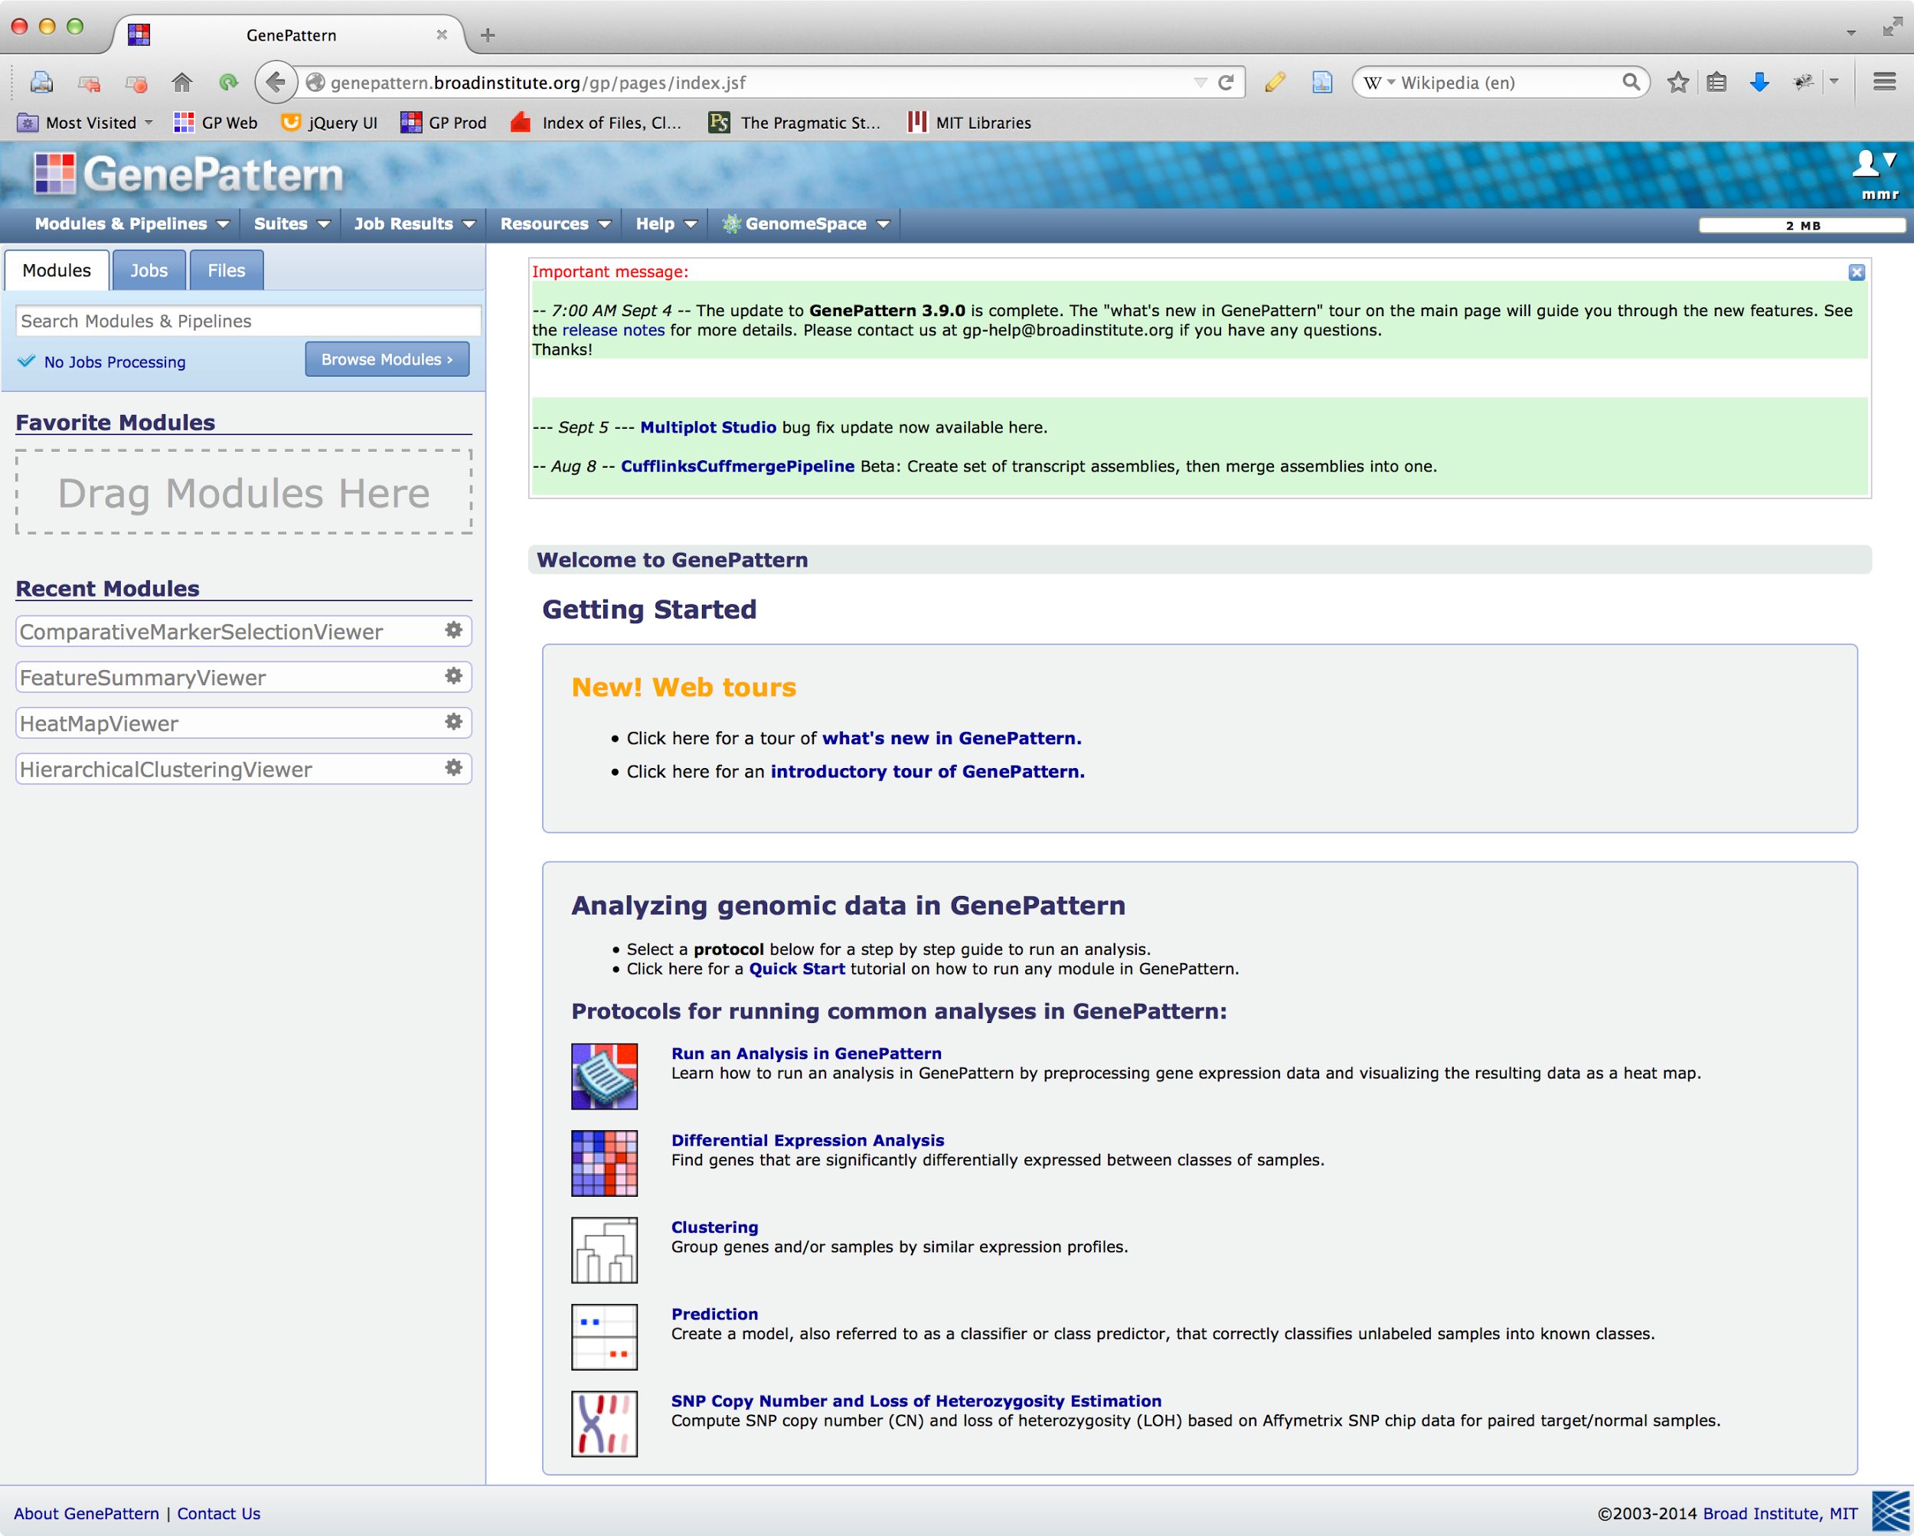


How GenePattern works
Repositories
Servers
GenePattern Users
GenePattern Server
Production
Repository
Modules
Pipelines
Jobs
Local GP Server
Modules
Pipelines
Jobs
Community
Repository
Local GP Server
Modules
Pipelines
Jobs
Notes:
This slide shows how the parts of GenePattern interact with each other and also
You can think of module repositories as individual iTunes stores..

Slide 14

Exercise #1
Notes:
Alright, alright, so enough talk. Let’s dive in. Sometimes the best way to learn is by doing.
So with that in mind, we’re going to do a bit of a follow-along exercise. And I’m going to explain things as we go.

Slide 15
Go to https://cloud.genepattern.org
Sign in using your GenePattern username and password.
On the left, search for ConvertLineEndings and click it in the list when it comes up.
Click “Add Path or URL” next to the “input filename” parameter and enter: https://datasets.genepattern.org/data/all_aml/all_aml_train.gct
Click Run.
Notes:
If you’ve navigated away from GenePattern. Let’s go back. Go to cloud.genepattern.org in your browser and sign in. If you’re already there, great! Just click back to the correct tab.
Then let’s run a module. In the search box on the left, I want you to type in ConvertLineEndings, and when a result comes up, click it.
What you now see is the run module page. It presents a simple web form where you can change the available parameters. And if you every need help understanding the parameters, you can access the module’s documentation by clicking the documentation link at the top of the form.
As far as modules ago, ConvertLineEndings isn’t very interesting, but it is fast – which is great for quick demonstrations. All it does is it changes the line endings in a text file from Windows-style encoded line endings to the Unix style of line ending. This is necessary for some older tools that get very picky about that sort of thing.
Anyway, in the “input filename” parameter, I want you to type the following URL: (sorry this isn’t something shorter) Then click run.
*Explain the job status page and note that GenePattern automatically downloads the file for you.*

Slide 16
g2nb
Notes:
GenePattern is available through a variety of interfaces. What we’ve used so far is the classic “web app” interface – and we’ll be coming back to it again – but GenePattern’s functionality is also available in Jupyter notebooks through a platform called g2nb.

Slide 17
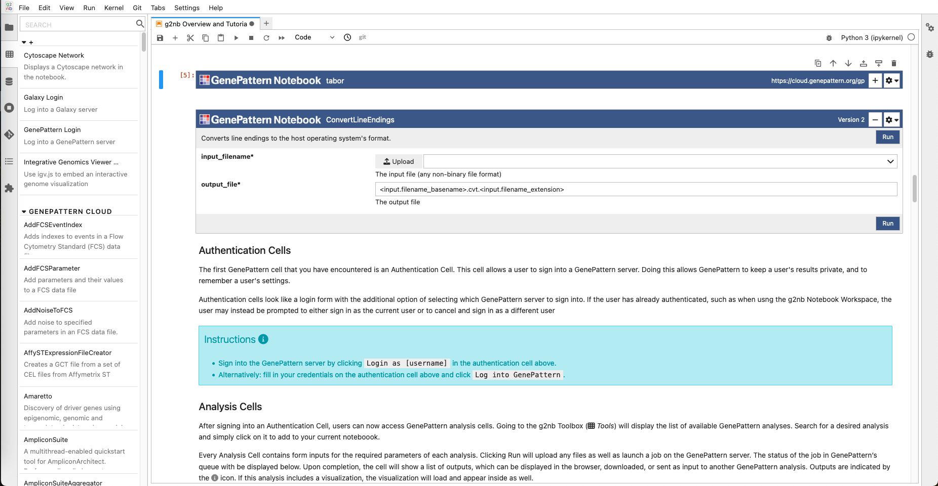
g2nb Workspace
Notes:
g2nb is an an environment that allows you to perform in silico research and present that research in the form of an interactive notebook in your web browser.
You can also think of g2nbk like this: If you work in a wet lab, a bench biologist has an ever-present lab notebook. For bioinformaticians, there’s no direct equivalent. g2nb helps bring these worlds together, so that you can keep your notes and your computational analyses together in an easy-to-understand, narrative format.
And this format is really intuitive. It’s a lot like how you might conceive of your research, or begin to structure a paper

Slide 18

Jupyter
Popular and well-supported framework for scientific computing
Ecosystem of available extensions and resources
Open source
Notes:
g2nb is built on top of a platform called Jupyter.
Who here is familiar with Jupyter?
*show of hands*
Jupyter is a popular and well-supported framework for scientific computing with a pretty vast ecosystem of integrations and other resources that are available.
It's open source software.
And g2nb lets you create bioinformatic notebooks that are compatible with it and all the associated resources that are available to you.

Slide 19




Complete Research Narrative
Leverages the best of Jupyter, GenePattern and other popular bioinformatics platforms
Interleave text, visualization, graphics and analytical aspects
Notes:
One of the underlying goals of g2nb is to encapsulate a complete research narrative—from its conception to dissemination.
Another goal is to make all of the powerful GenePattern features, and features from other popular bioinformatics platforms, available in the notebook environment. This way a researcher can leverage the best of what eah has to offer, interleaving text, graphics, interactive visualizations and analytic aspects.

Slide 20
Exercise #2
Notes:
That’s the pitch. Let’s get interactive.
For this next exercise, we’re going to try out using GenePattern from the g2nb interface, inside a Jupyter notebook.

Slide 21

1. Sign in at:
workspace.g2nb.org
No spaces or special characters in usernames
!@#$%
^&*()_
Notes:
Please open a new tab and point your browser at workspace.g2nb.org. Once you’re there, you should see a login page. Go ahead and click on the GenePattern link, and then sign in with your GenePattern username and password.
I’ll give everyone a couple minutes to get caught up.

Slide 22
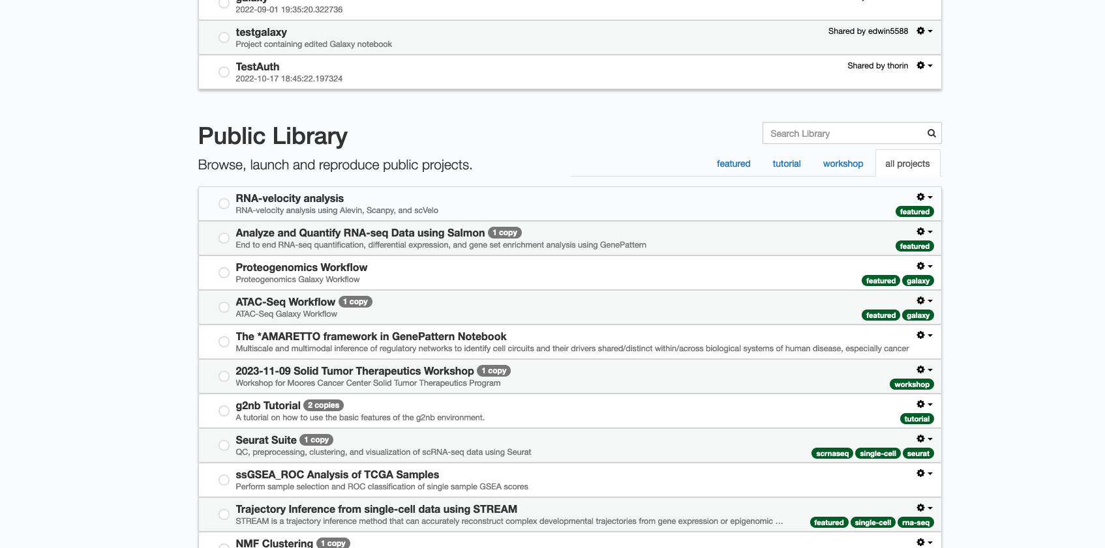
2. Run the workshop project:
2024-08-16 MSTP Bootcamp
Notes:
Once you’ve logged in, you should see a screen that looks something like this. This is your notebook projects page. We’ll talk more about it later, but basically a project is a complete computational environment that can be prepared ahead of time and launched with the click of a button.
For this workshop we’ve created a project called “2024-08-16 MSTP Bootcamp”. If you scroll down to the section named “Public Library” and search in the search box there, you should be able to find this project. Just start typing 2024, hit enter and it should come up.
Once you’ve located the correct project, click on it and it will give you a dialog showing you the project’s name, description, environment and other technical information. Once you see this dialog, click the blue “Run Project” button.
This will boot up the project for you, but first you will see a loading spinner and it might take a minute to two, particularly because everyone in the workshop is starting it up at once and that can slow things down a little bit, since it’s queueing each of these launches. Just be patient.
I’ll give everyone a couple minutes to get their projects launched. In the meantime, we’ll be walking through the room just to make sure everyone’s caught up before moving on.

